Slide 1
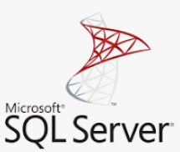



Introduction
In this PoC we are performing transformations on data in a MS SQL server using dbt and orchestrating those processes using Airflow. All those processes are running in Docker containers.

Slide 2
x
x

